Slide 1
CCRI: SUCCESS MADE HERE
Sit Up, and Take Notes!
Notetaking ABCs and 123s
By Kimberley Edgar
Academic Coach
Community College of Rhode Island
Student Success Center
ktedgar@ccri.edu

Slide 2
WHAT’s IT WORTH?
Do you want to pass or fail?
Dr. Walter Pauk, of Cornell University’s Reading and Study Center, found students who record:
No notes
Forget 60 percent in 14 days (2 weeks)
Some notes
Remember 60 percent of material
Systematic notes and study them …
Retain 90-100 percent INDEFINITELY

Slide 3
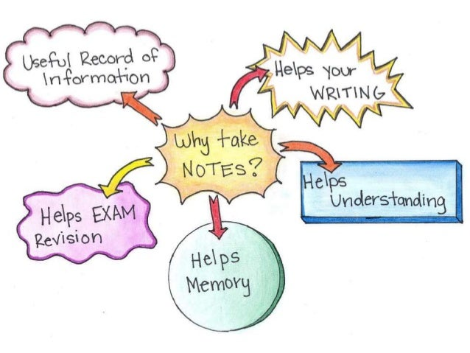
UNDERLINING VALUE
Taking good notes:
Keeps you alert
Promotes active listening
Improves recall, memorizing concepts
Engages your mind
Requires thinking about writing
Cultivates meaningful learning skills
Emphasizes, organizes info
Helps connect topics
Increases topical understanding
Creates a condensed study record
Serves quality review after class
Reduces stress when test time arrives!

Slide 4
VERSATILE STUDY SKILL
Note-taking is beneficial for:
Lectures & Labs
Creates 2-way communication
Promotes class participation
Helps identify, focus questions, clarifications
Documents observations
Readings
Process, digest material
Keep on target
Synchronous/Asynchronous Learning
In-person/Remote

Slide 5
COMING to TERMS
Synchronous
Live: students, professor meet together
In-person, online, hybrid
Asynchronous
Student in driver’s seat
Sets pace
Covers material on own
May have to view recording/s
Remote
Off campus
Usually online or no connection
In-person
On campus, same physical space

Slide 6
STEP 1: BE PREPARED
Notebook – handwritten notes preferred
Writing implements – pens, pencils, colored pencils, highlighters, erasers, etc.
Listening ears – open mind and active listening
https://www.developgoodhabts.com/rock-pebbles-sand/

Slide 7
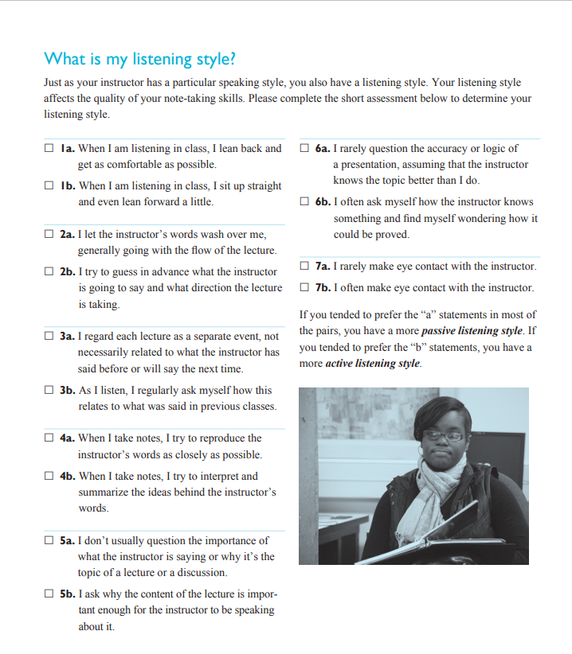
WHAT’s YOUR LISTENING STYLE?

Slide 8
STEP 2: LISTEN UP!

Slide 9
ACTIVE LISTENING
Style
Good note-takers are …
Active listeners
Active listeners …
Are fully attentive
Try to understand speaker’s intent
Active listening requires …
Physical attention
Mental attention
Energy
Concentration
Discipline

Slide 10
ACTIVE LISTENING
Strategies:
Be open, willing to learn.
Reduce distractions.
Listen to what the speaker is saying.
Concentrate: Don’t let mind wander.
Observe.
Look at the main idea/s.
Be quiet.

Slide 11
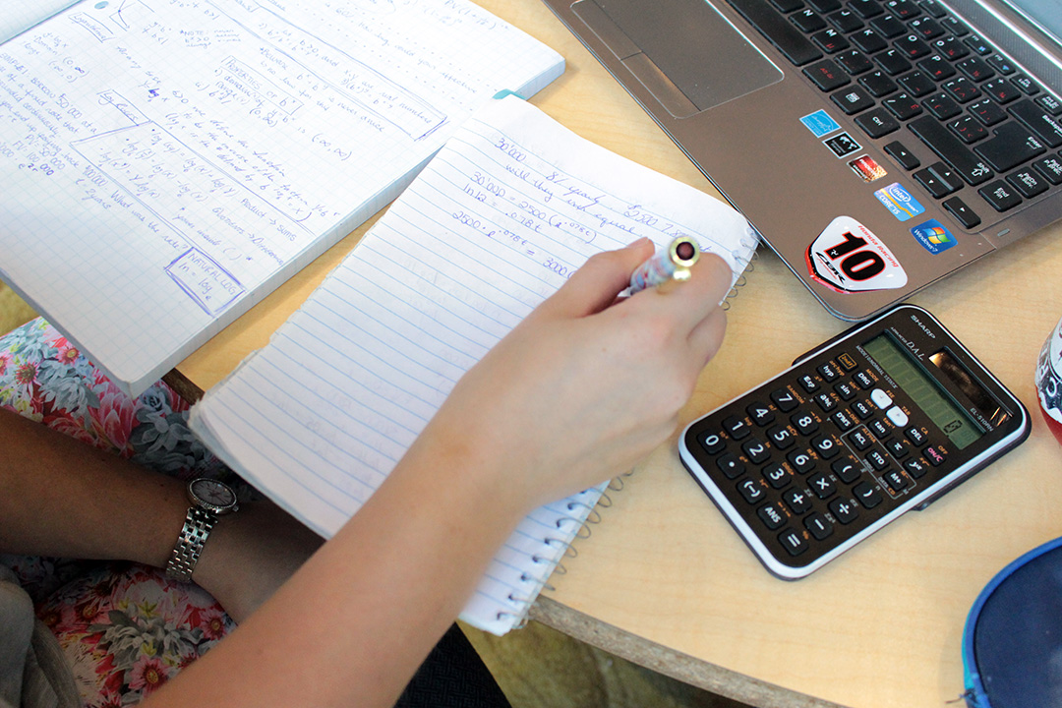
ASYNCHRONOUS NOTETAKING
Recorded Lectures:
Treat like synchronous lectures
Schedule time in planner to view
Plan “class” as early in day, as early in week as possible
Watch at reg. speed w/out stopping
(research shows benefits diminish by 1.25x if you increase speed)
Take notes as usual in live class
Log time in the margin
Readings-only:
Treat like synchronous lectures
Block off time in planner for “class”
Schedule “class” as early in day, as early in week as possible
Substitute readings in lieu of lecture
Take notes

Slide 12
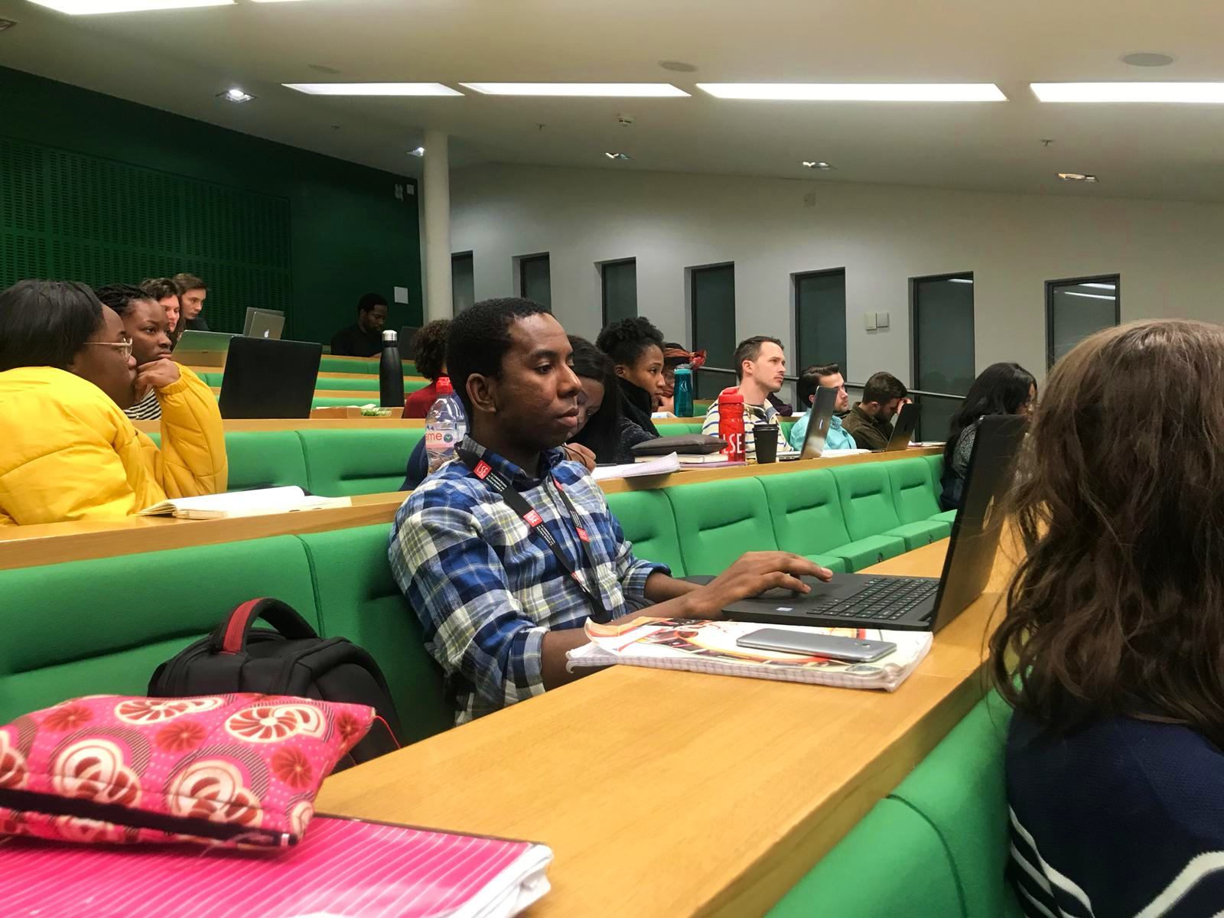
SYNCHRONICITY: LECTURE
Do’s
Attend ALL lectures
Be punctual
Seek permission to record
Take notes during lecture
Highlight main ideas
Organize key points
Compare/contrast
Watch for patterns
Review notes weekly
Don’ts
Write down every word
Sit passively
Let ?s go unasked
Fall asleep
Ignore study helps

Slide 13
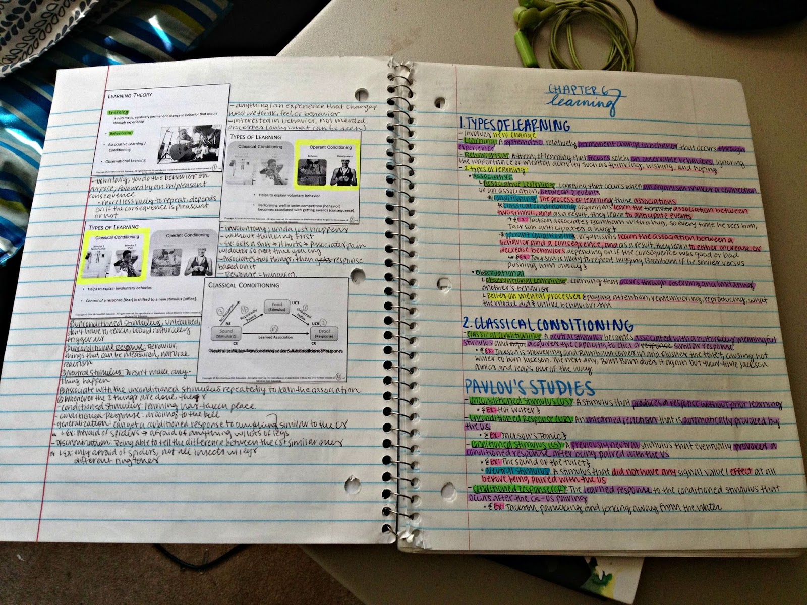
SYNCHRONICITY: READINGS
Textbooks, ebooks, etcetera
Use lecture tips, techniques
Less is more!
Vary the color
Create flashcards
Create an outline
Jot notes in margins
Talk w/your professor/s
Use your own words
Answer chapter-end ?’s

Slide 14
STEP 3: DECIDE WHAT TO NOTE
https://youtu.be/UAhRf3U50lM
Focus on info reflecting main themes
Key words on overheads, whiteboards, chalkboards, textbook readings, etc.
Info repeated OR confusing
Details enhancing readings, previous lectures

Slide 15
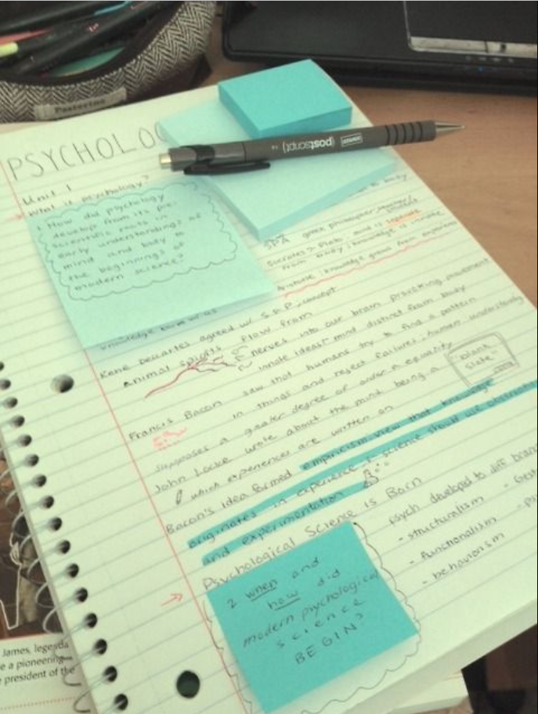
STEP 4: GET A SYSTEM
5 Main Notetaking Methods
The Cornell Method
The Mapping Method, or Mind-mapping
The Outlining Method
The Charting Method
The Sentence Method

Slide 16
CORNELL NOTETAKING SYSTEM

Slide 17
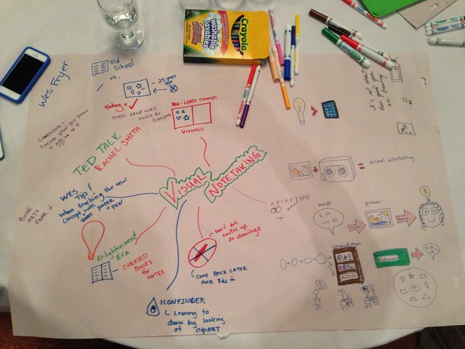
MIND-MAPPING STRATEGY

Slide 18
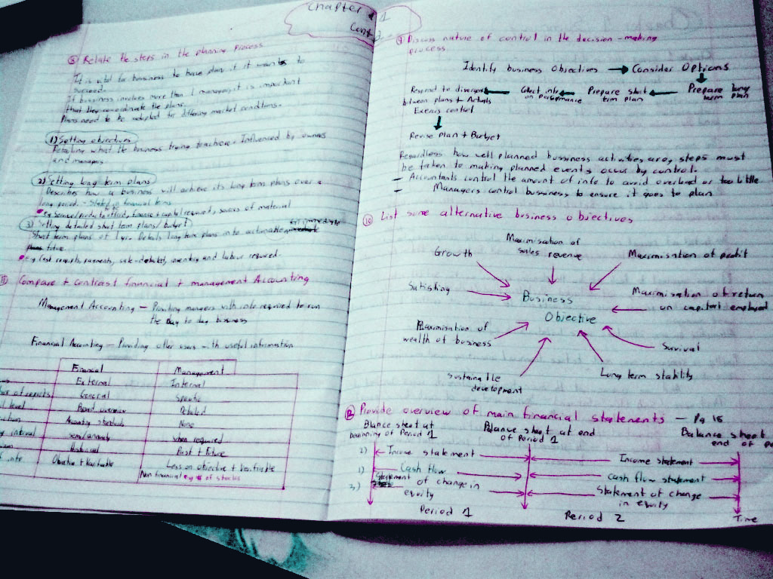
SUCCESS MADE HERE!
Student Success Center
Notetaking Skills
Social Sciences Students
Presenter: Kimberley Edgar
Academic Coach: ktedgar@ccri.edu
Resources
Notetaking Handout Listening Style Assessment, /P2
https://www.ccri.edu/success/pdf/2021_SC_Notetaking-
FINAL.pdf
Book Your Tutoring Appointment:
https://www.ccri.edu/success/

